Slide 1




NEXT GEN EMPLOYABILITY PROGRAM
Creating a future-ready workforce
College Name
Student Name :Thenmozhi M
Student ID :autb21csl012
Arasu Engineering College

Slide 2

CAPSTONE PROJECT SHOWCASE
Project Title
Voting Application using Django Framework-THENMOZHI MARIYAPPAN(4314,AEC)
Abstract | Problem Statement | Project Overview | Proposed Solution | Technology Used | Modelling & Results | Conclusion

Slide 3
Abstract
The proposed voting application is a web-based platform that allows users to create and participate in online votes. The application is built using the Django framework, a popular and well-supported Python-based web framework that provides a robust foundation for building scalable and secure web applications . The application is also designed to be flexible and scalable, with a modular architecture that allows for easy customization and extension. This makes it suitable for a wide range of use cases, from small-scale internal votes to large-scale public elections . Overall, the proposed voting application is a secure, user-friendly, and flexible platform for conducting online votes. Its use of the Django framework ensures a robust and scalable foundation, while its focus on security and user experience makes it an ideal choice for a wide range of voting scenarios.

Slide 4
Problem Statement
Online voting has become increasingly popular in recent years, with a growing number of organizations and governments turning to digital platforms to conduct elections and polls. However, online voting also presents a number of challenges, particularly in terms of security and integrity . Overall, the proposed voting application will address the challenges of security and integrity in online voting, while also providing a user-friendly platform for conducting online votes. Its use of the Django framework will ensure a robust and scalable foundation, while its focus on security and user experience will make it an ideal choice for a wide range of voting scenarios.
In addition to its focus on security, the application will also prioritize user experience, with a clean and intuitive interface that makes it easy for users to create and participate in votes. The application will support multiple types of votes, including single-choice and multiple-choice votes, and will allow users to set deadlines and restrictions for each vote.

Slide 5
Project Overview
The project overview for a voting application using the Django framework involves creating a secure and user-friendly online voting system. The application allows users to register, vote, and view real-time results. Here is a steps involved in building the voting application:
Setting up a Django Project: Create a Django project to serve as the foundation for the voting application.
Designing the Database Schema: Define the database structure to store user information, votes, and other relevant data.
Creating User Authentication: Implement user authentication to allow users to register, log in, and participate in voting.
Building the Voting Interface: Develop the interface where users can view options, select their choices, and submit votes.
Implementing Real-time Results: Display the voting results dynamically to provide instant feedback to users.
Developing an Admin Panel: Build an admin panel to manage the voting process, candidates, and user accounts effectively.

Slide 6
Proposed Solution
.
The proposed solution for a voting application using the Django framework is to create a secure and user-friendly online voting platform. The application will allow users to register, vote, and view real-time results . To build the application, the Django framework will be used as the foundation due to its robustness and scalability. The application will have a user-friendly interface, a secure database, real-time results, and an admin panel for efficient management of elections, candidates, and user accounts. In summary, the proposed solution for a voting application using the Django framework is a secure, user-friendly, and flexible platform for conducting online votes. Its use of the Django framework ensures a robust and scalable foundation, while its focus on security and user experience makes it an ideal choice for a wide range of voting scenarios.

Slide 7
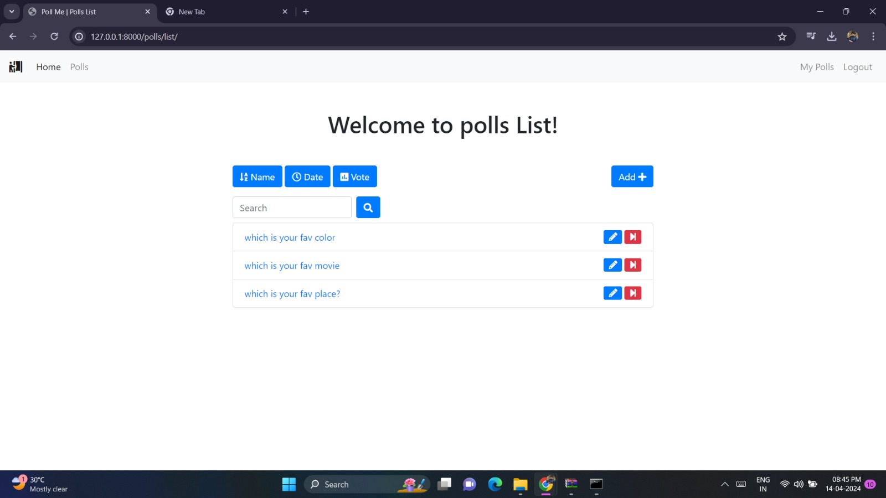
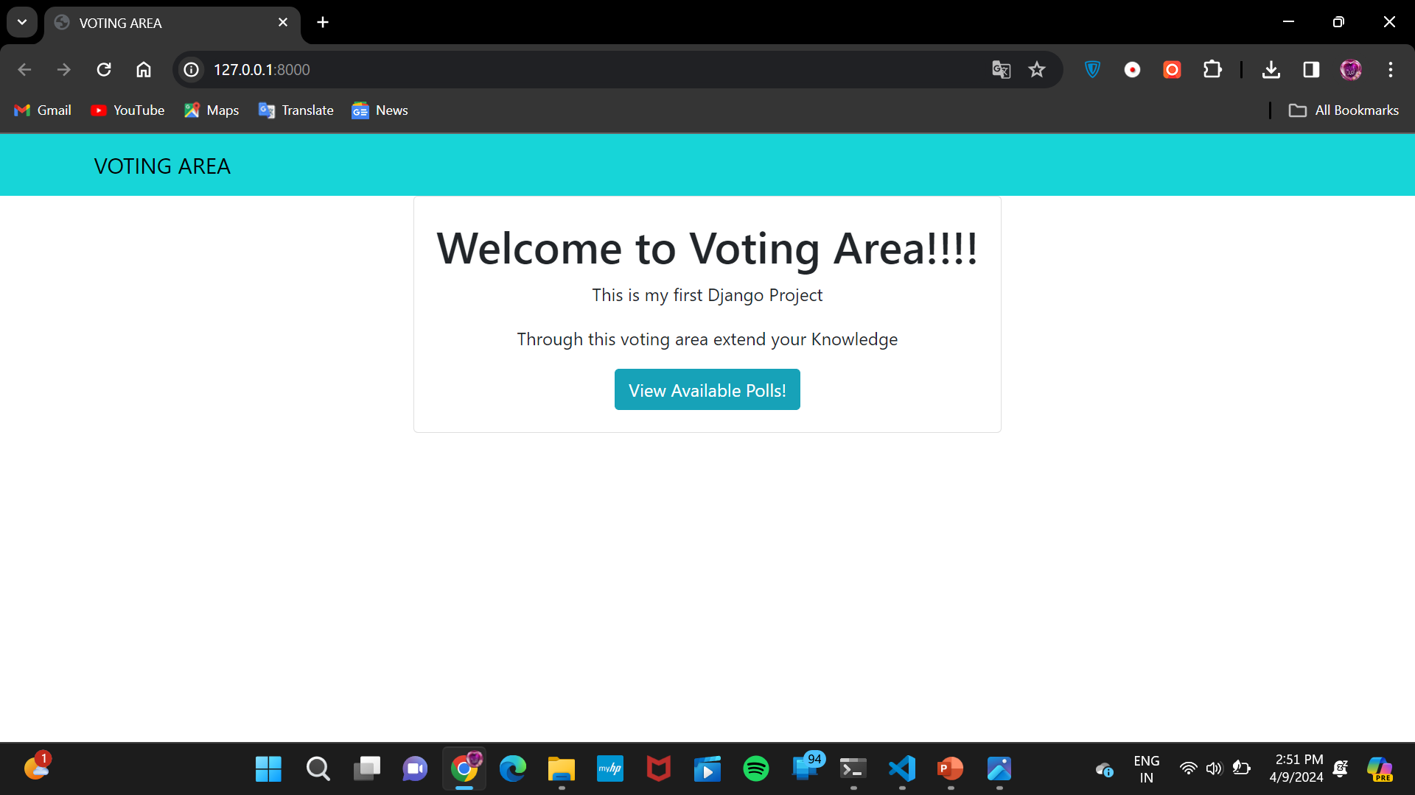
Home Page

Slide 8
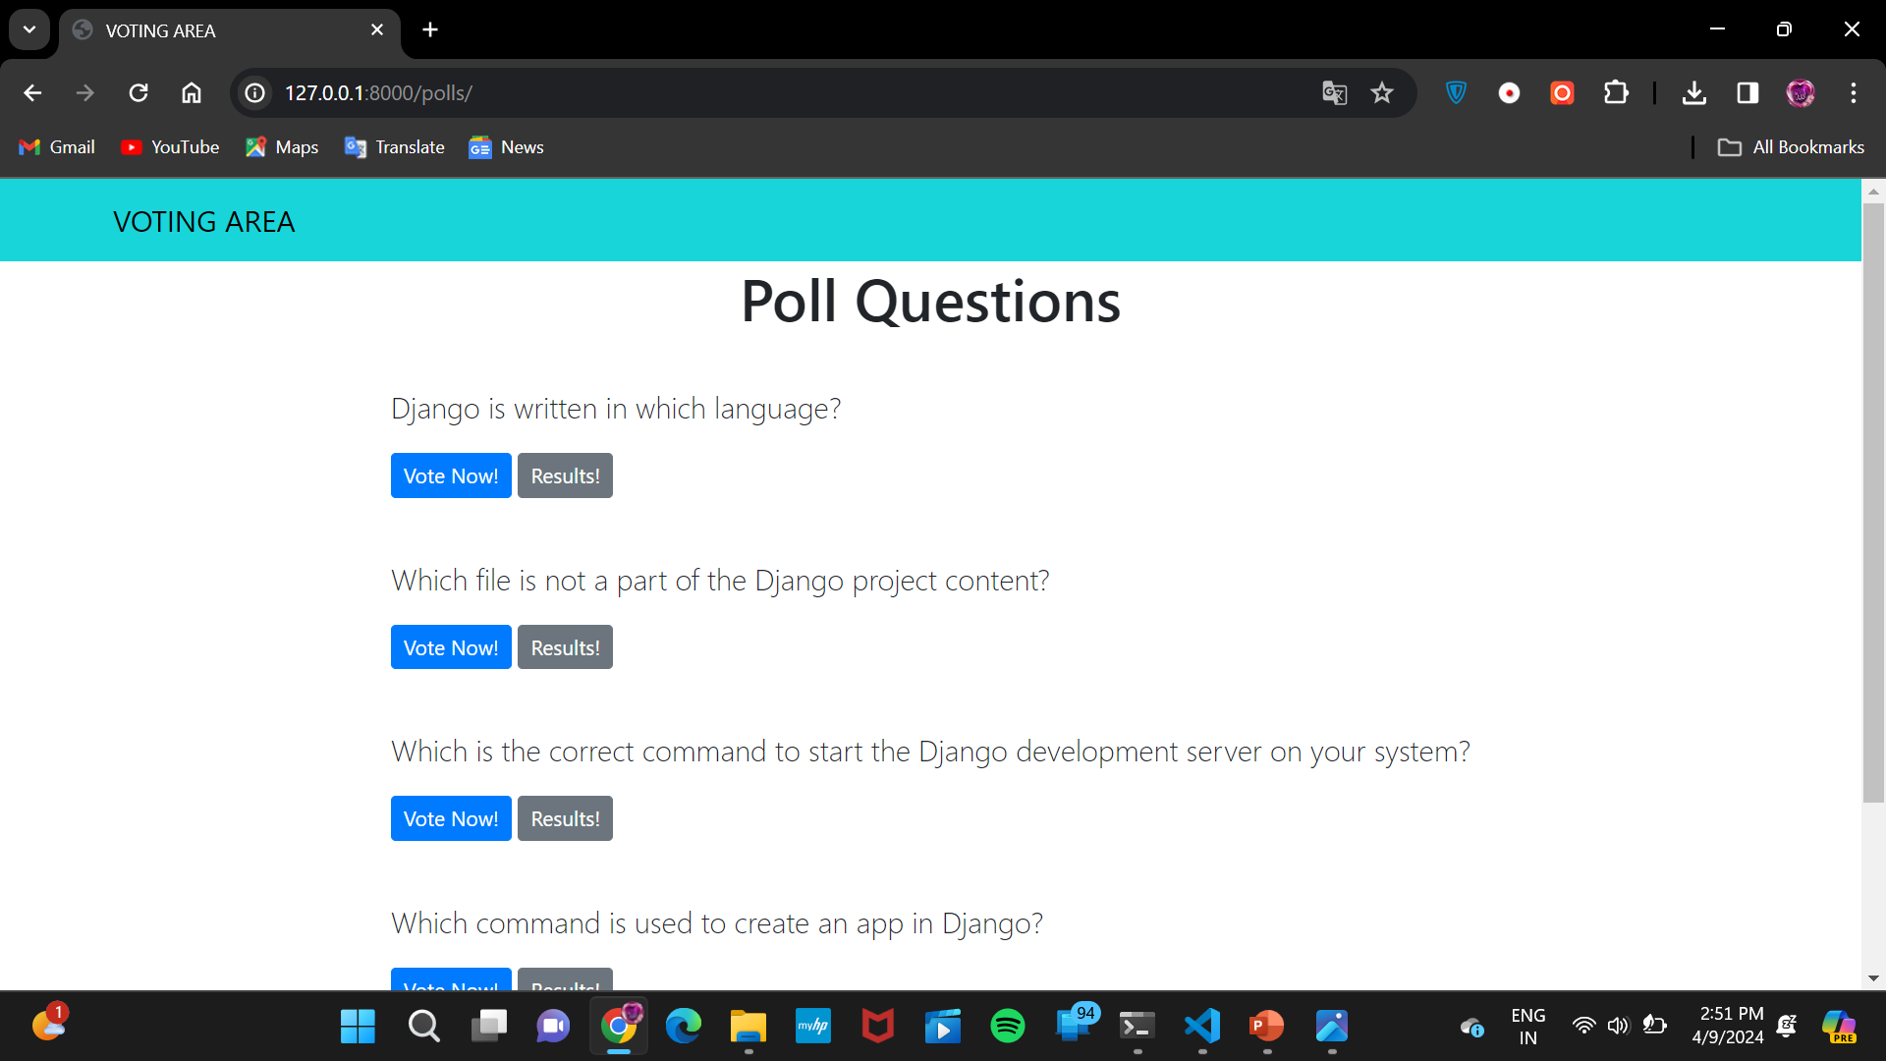
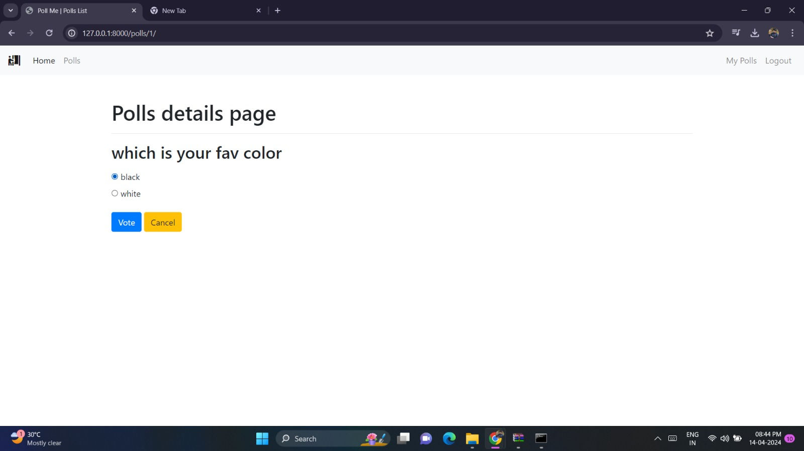
Poll Page

Slide 9
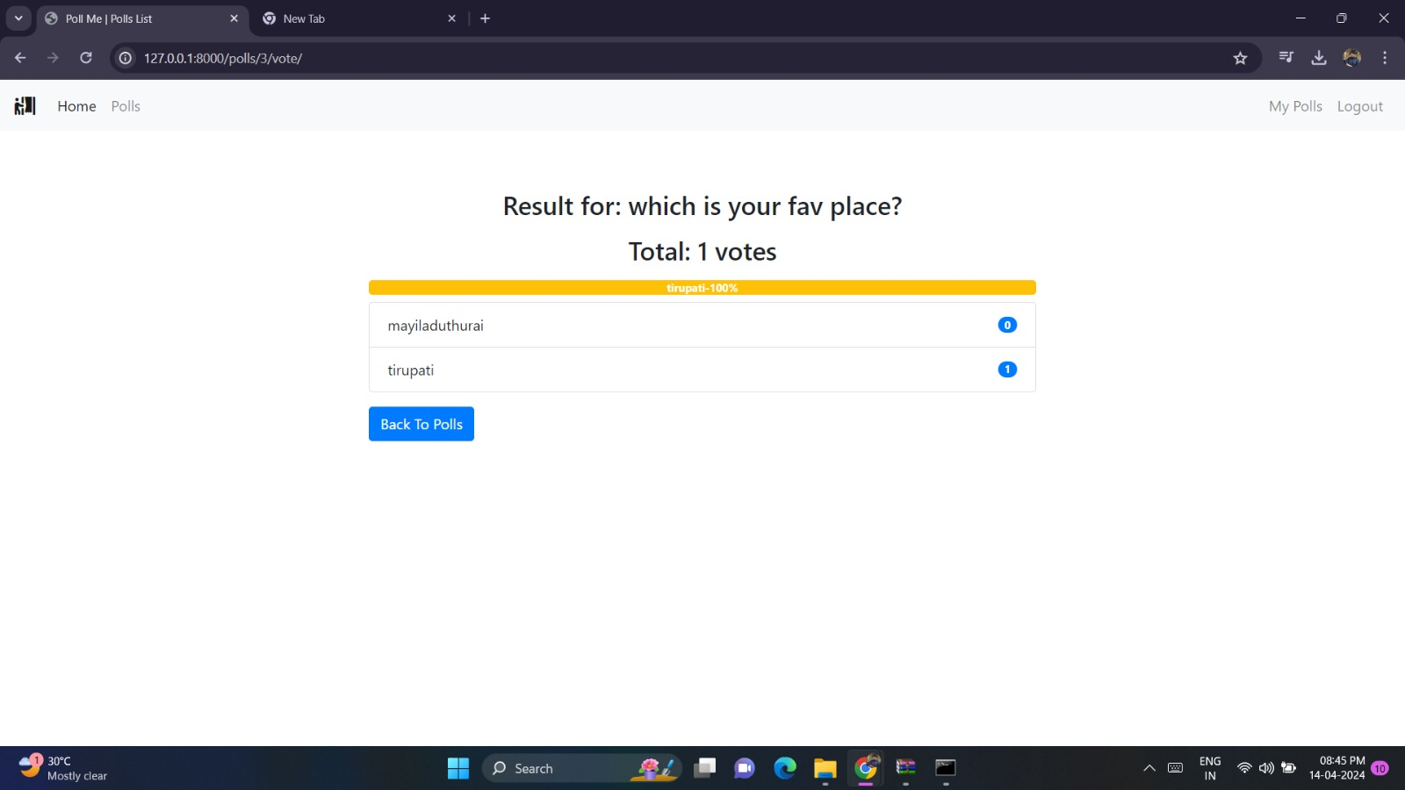
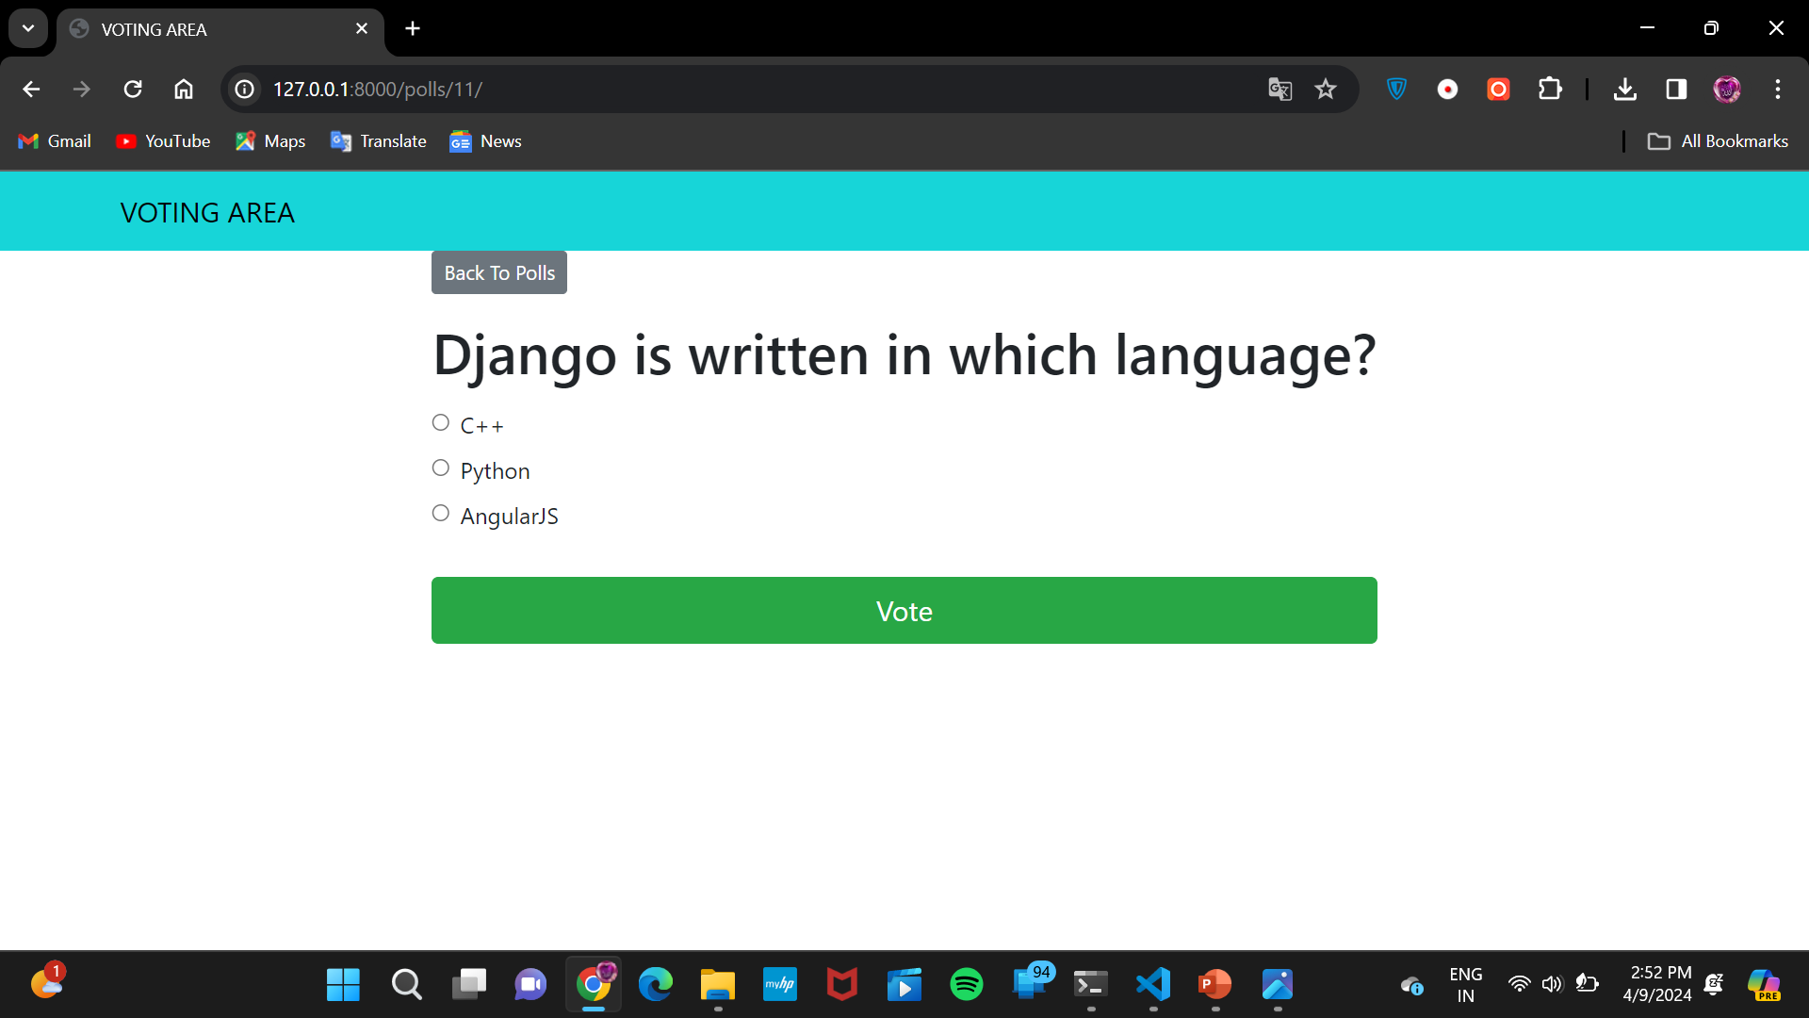
Voting Page

Slide 10
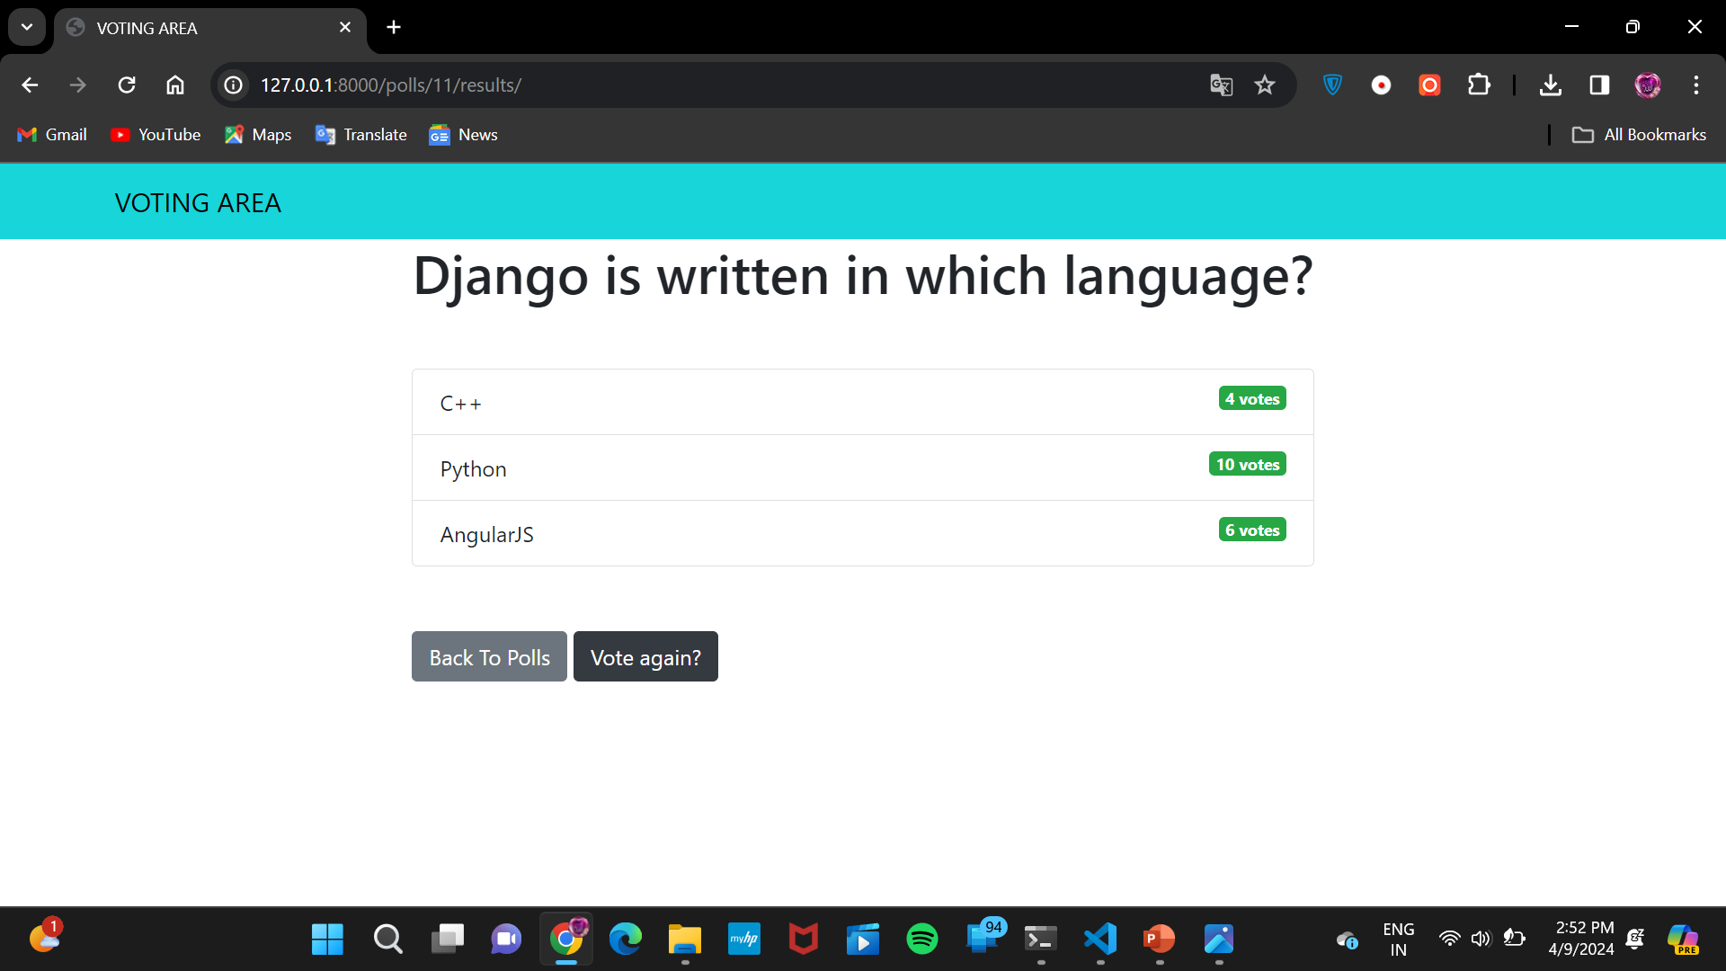
Voting Details Page

Slide 11
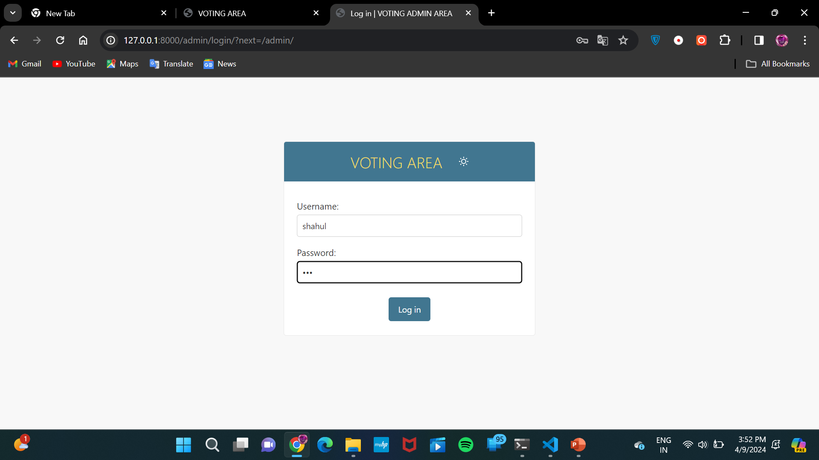
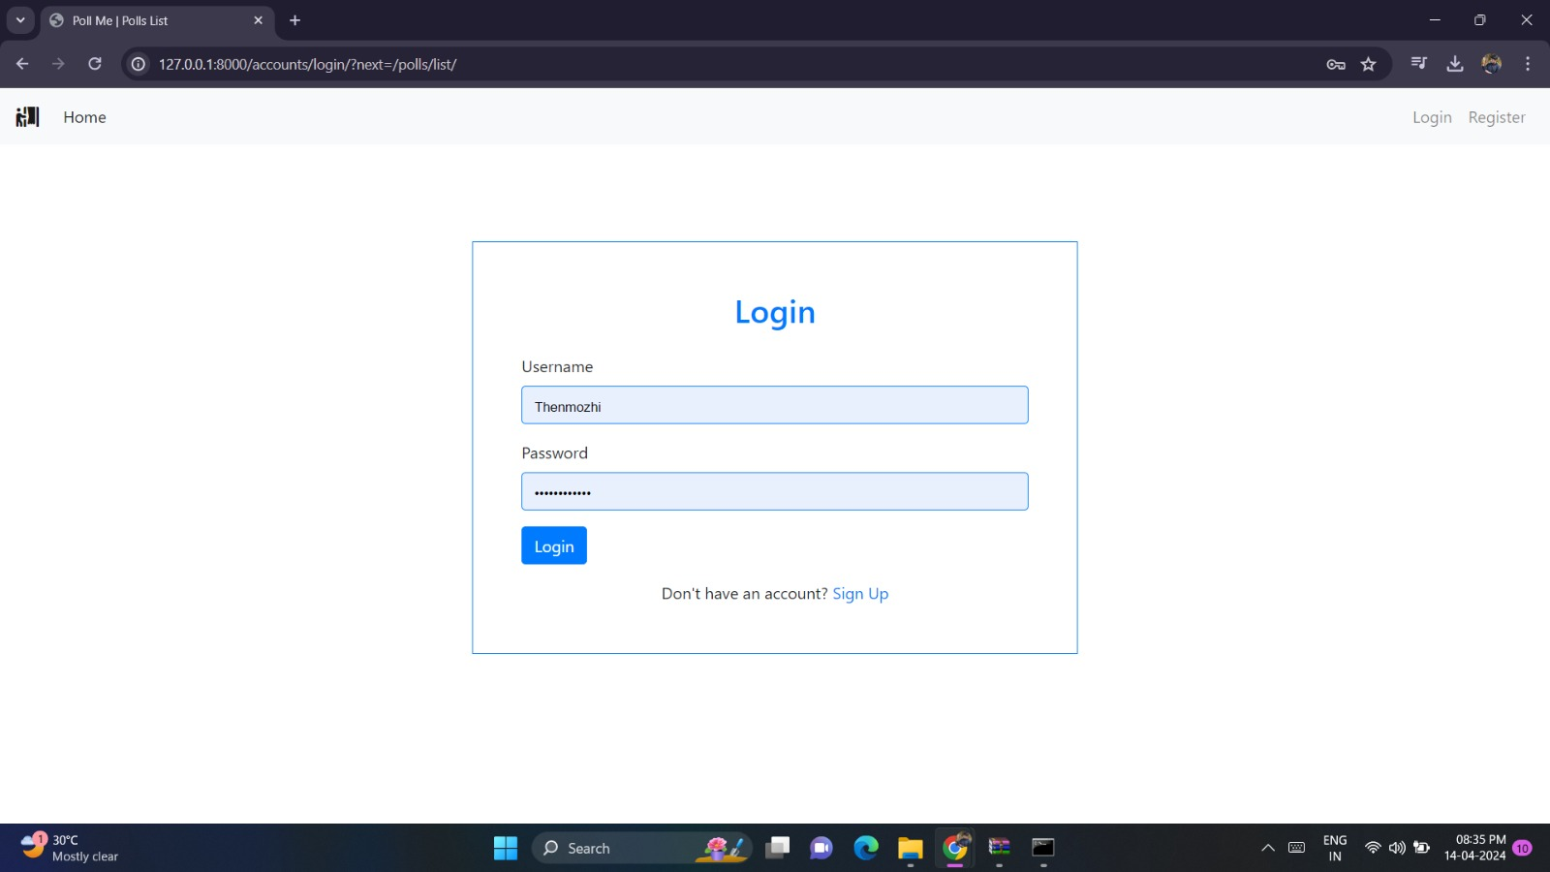
Admin Login Page

Slide 12
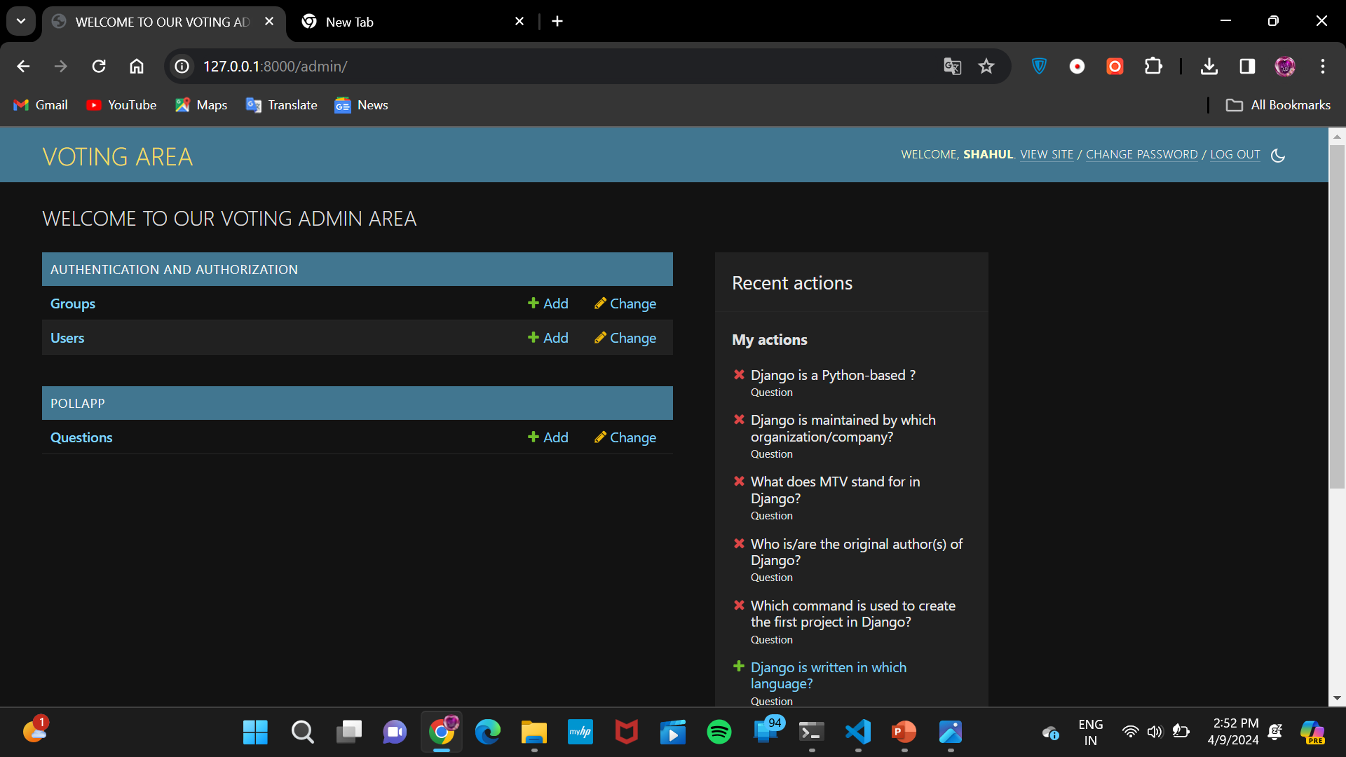
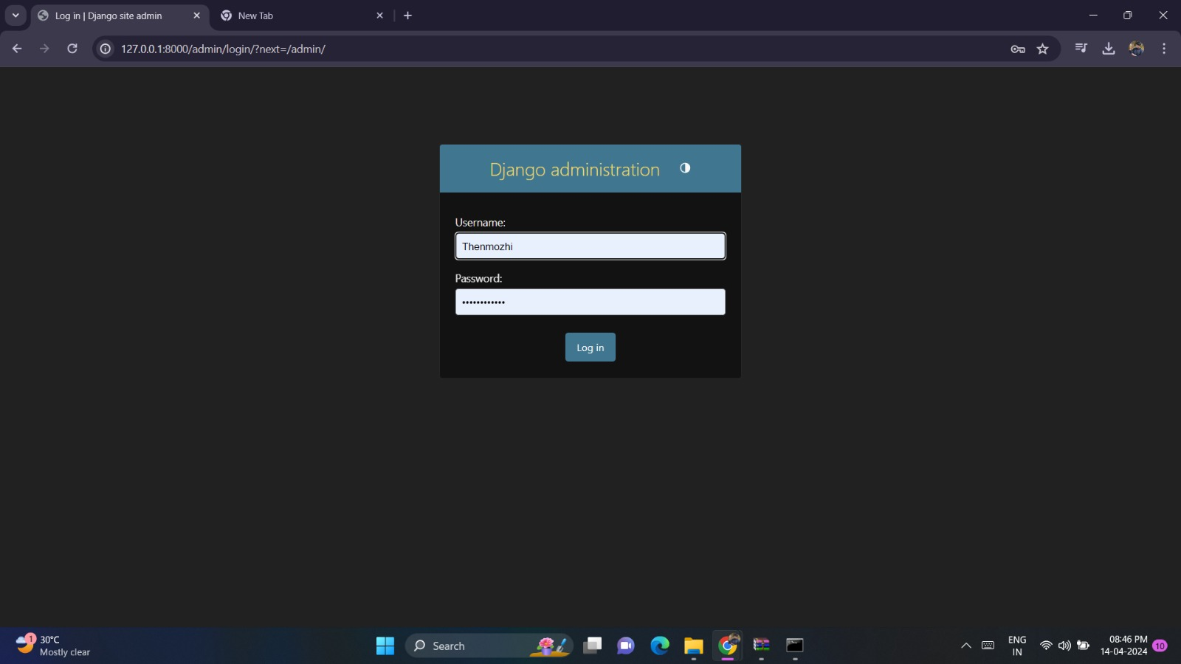
Admin Home Page

Slide 13
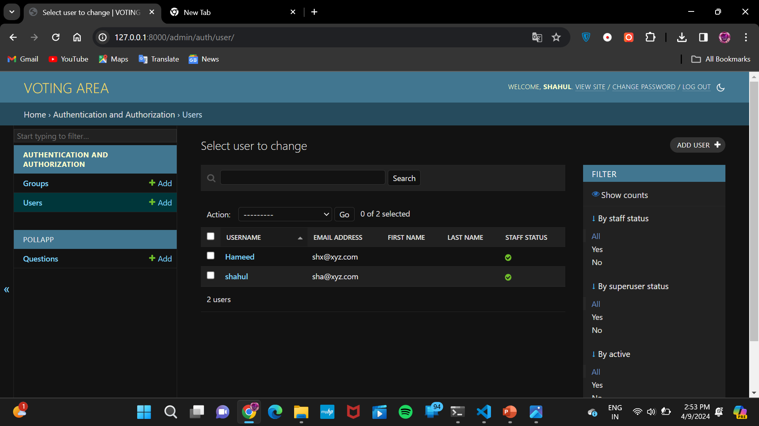
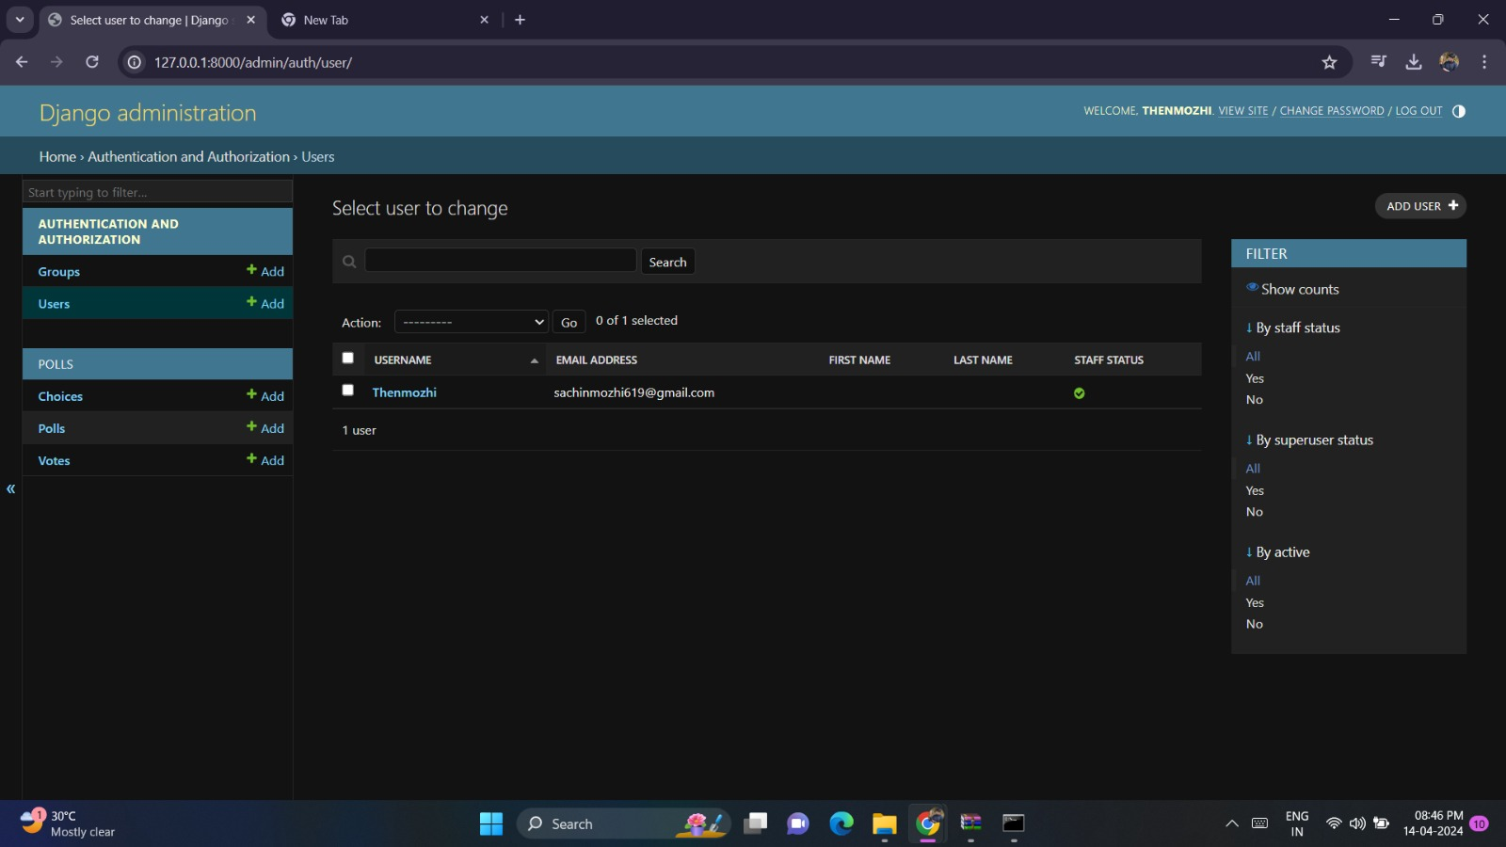
Authentication and Authorization Page

Slide 14
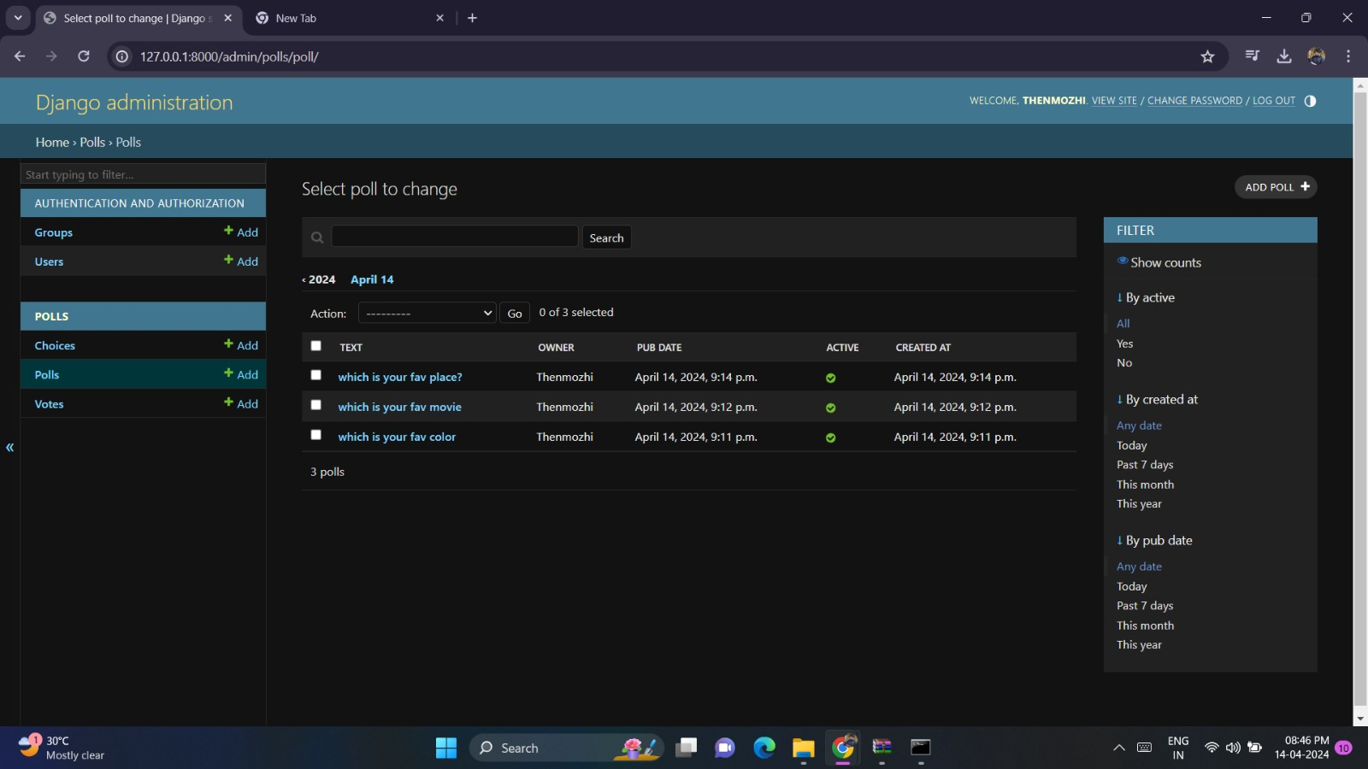
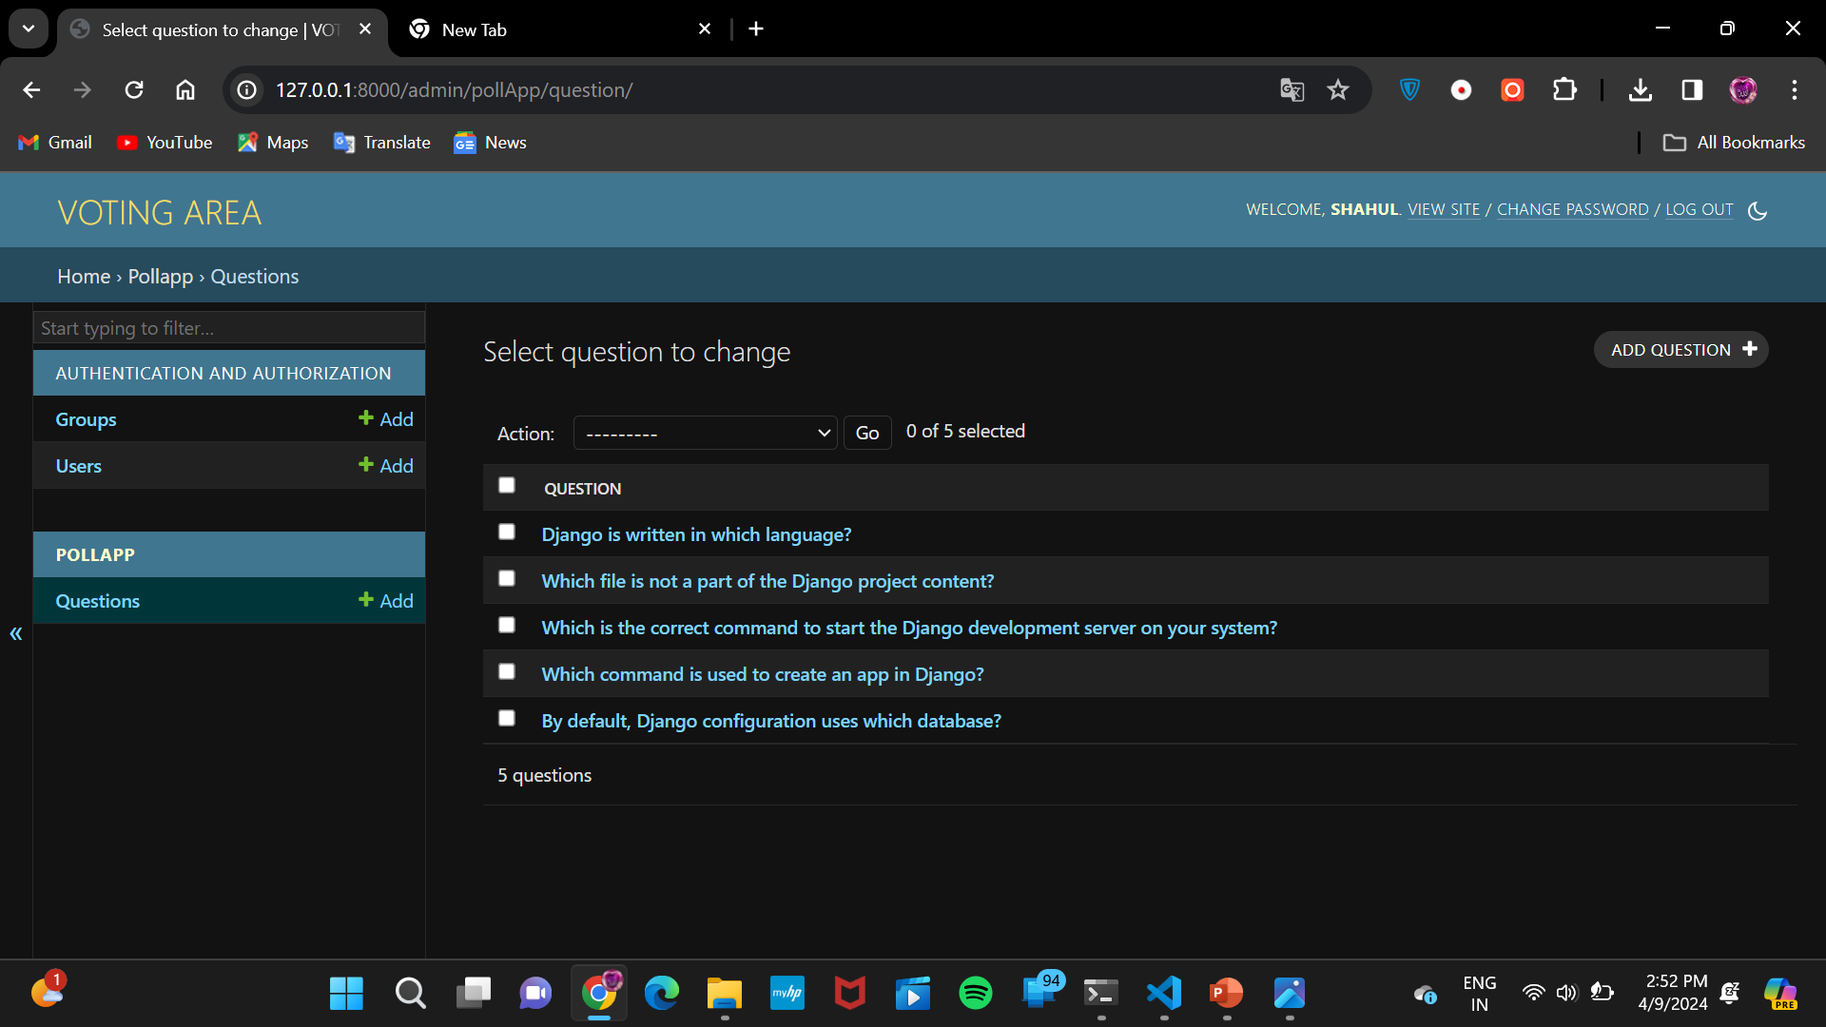
Questions Adding Section Page

Slide 15
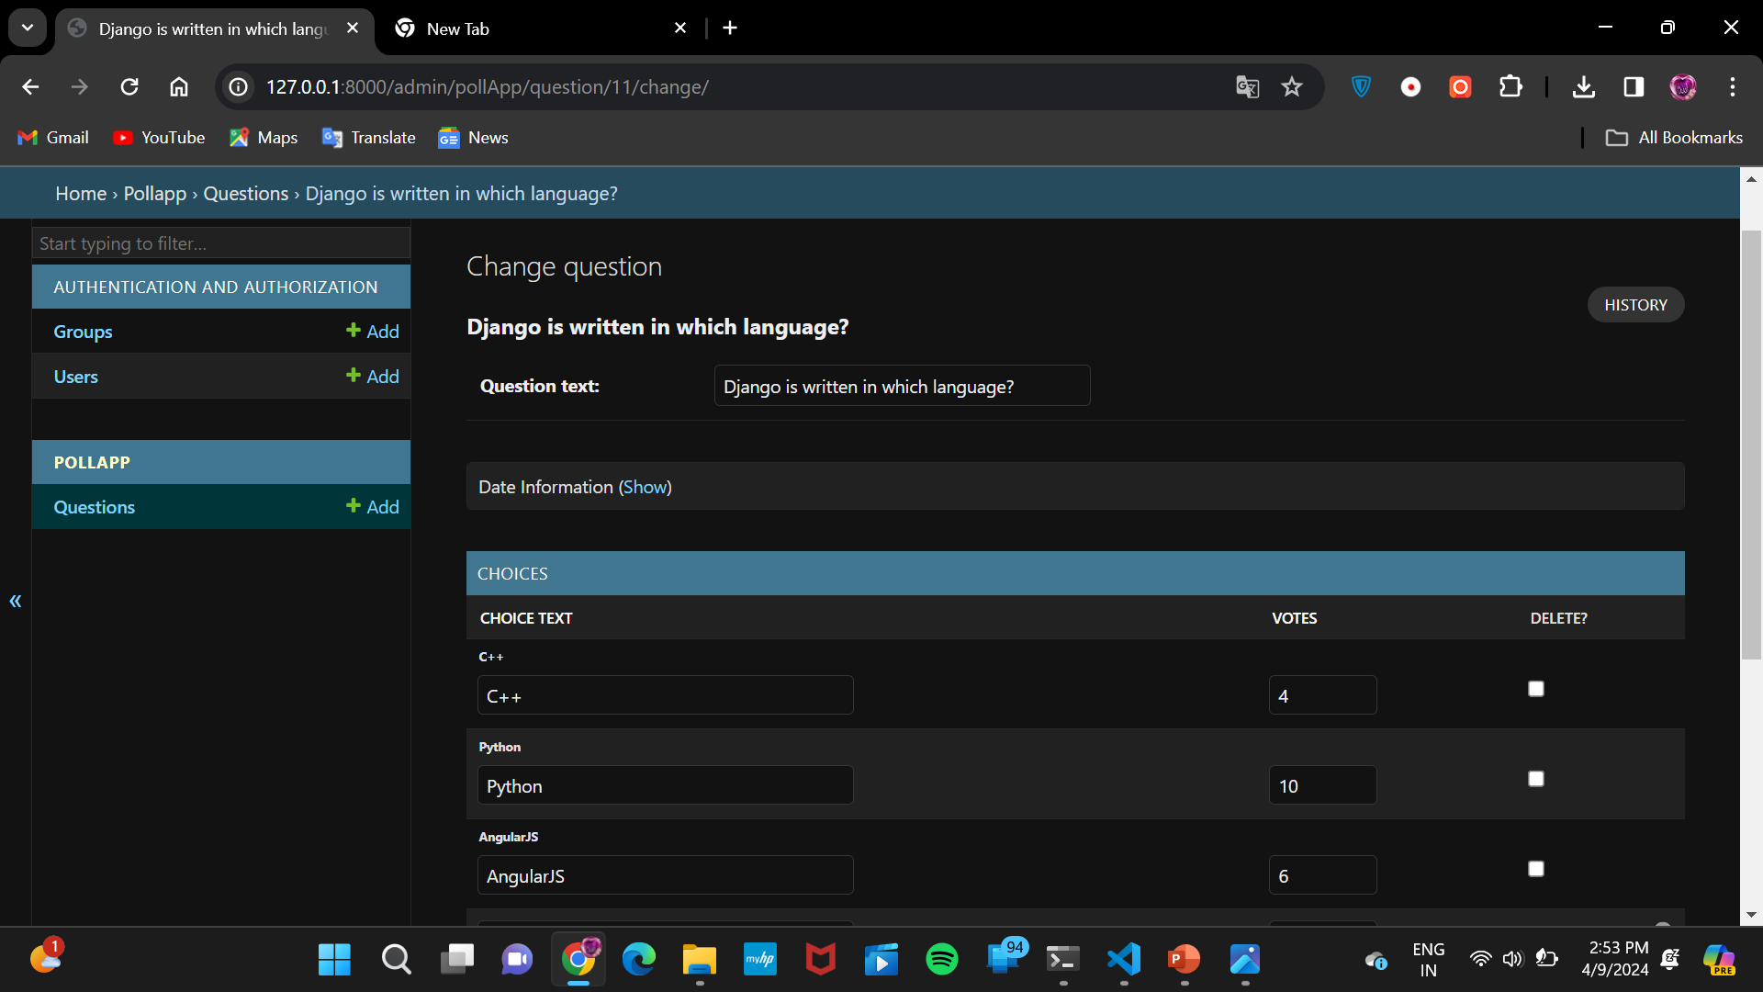
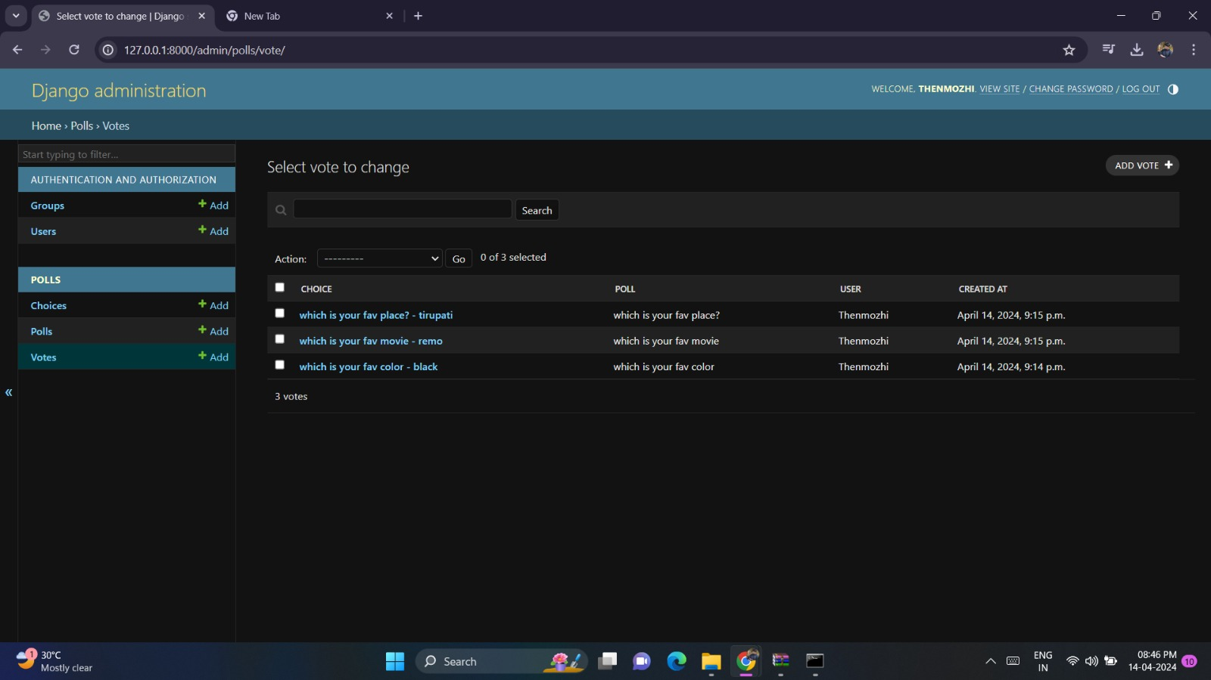
Voting Details Page

Slide 16


Technology Used
Front-end
Back-end

Slide 17
Future Enhancements:
Future enhancements in a voting application using the Django framework, several key features and improvements can be considered based on the information from the provided sources,
1.Asynchronous Programming: Implementing asynchronous programming can enhance the performance of the application by allowing tasks to run concurrently, improving responsiveness and scalability.
2.Microservices Architecture: Adopting a microservices architecture can make the application more modular, easier to maintain, and scalable by breaking it into smaller, independent services that communicate with each other
3.Serverless Computing: Utilizing serverless computing can optimize resource utilization and reduce costs by enabling automatic scaling and only paying for actual usage, enhancing the application's efficiency and cost-effectiveness.
4.Client-Side Encryption: Enhancing security by implementing client-side encryption can protect sensitive data and ensure the confidentiality of votes, contributing to a more secure e-voting platform.
5.Blockchain Technology: Integrating blockchain technology can provide transparent and verifiable voting processes, ensuring the integrity of elections and promoting trust in the system

Slide 18
Conclusion
To create a voting application using Django, one should have a solid understanding of Python programming, Django framework, HTML, CSS, and Bootstrap. The development process involves creating a new Django project, creating a Django app, defining models, creating views, defining templates, and creating URLs.
The application can be further enhanced with features such as real-time results, a user-friendly interface, and a secure database design. It can also include an admin panel for managing elections, candidates, and user accounts.
Overall, a voting application using the Django framework is a powerful and flexible solution for creating online voting systems that can cater to various use cases and requirements.

Slide 19
Thank You!
Notes:
Thank You !!

